Slide 1
Object Oriented programming in Java

Slide 2
What is an Object?
multiple pieces of data and the methods who act on this data under a single data type
location for the data in the actual variable as a "reference“
rely upon the methods provided by the object
Null as analogous to zero for primitives, on objects

Slide 3

Arrays
object that holds multiple pieces of the same type of data.
Each element has an index
When you first create an array it is filled with "zero values".
Syntax to update the value stored in an index:
dataType[] arrayVariableName = new dataType[numberOfElementsToStore];
arrayName[index] = value;

Slide 4
We can also create an Array and fill it with values in a single statement
Arrays and Methods
"IndexOutOfBoundsException“: trying to access an index that does not exist, or beyond the capacity of the array.
dataType[] name = {dataValue1, dataValue2, dataValue3};
public static int[] myMethod(int[] a) {}

Slide 5
Array attributes, methods and Arrays class
Attribute that tells us the length of an array:
Java provides a class for handling arrays, called Arrays :v
arrayVariableName.length // returns the capacity of the array
int[] b = new int[10]; System.out.println(Arrays.toString(a));
Always use Arrays.toString() to output the value of an array, otherwise you just get the addres in memory

Slide 6
More useful methods
method | example | description
toString(array) | Arrays.toString(a) | returns a String representation of the array using square brackets and commas like so: [value, value, value]
equals(array1, array2) | Arrays.equal(a, b) OR a.equals(b) | returns true if the two arrays contain the same elements in the same order
fill(array, value) | Arrays.fill(a, 10) | fills every index of the array with a copy of the given value
copyOf(array, newLength) | Arrays.copyOf(a, 10) | creates a new array object with the given length and fills it with values in the same order as the original array. If there are left over indexes those are filled with the data type's zero value
sort(array) | Arrays.sort(a) | arranges the values in the array in sorted order from smallest to largest
binarySearch(array, value) | Arrays.binarySearch(a, 100) | returns the index of th given value in a sorted array. Will return a negative number if the value doesn't exist in the array.

Slide 7
Reference Semantics vs Value Semantics
Primitives are stored directly in memory
when you copy a primitive variable the value is copied, leaving the original variable unaffected (Value semantics)
Object variables store addresses, but the data is stored on a special space in memory
Any variable holding an object, stores a reference
When we copy these variables, we copy the address, resulting in both pointing to the same data. (reference semantics)

Slide 8
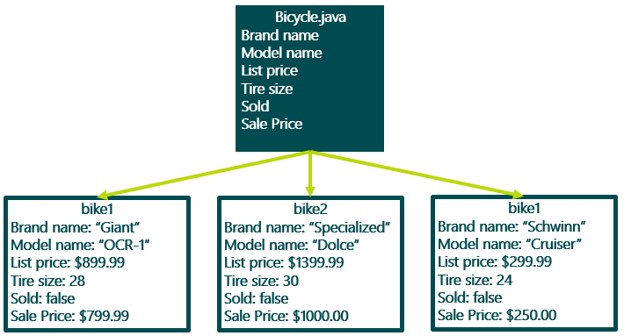
Creating Objects
have to write a class that "defines" it.
this class does not have a main method
must instead be invoked by a different class that does have a main method.
The class is a “mold”, the instance or the object invoked is a “particular individual of that design”
Bicycle bike1 = new Bicycle();
Creating instances on the main method

Slide 9
Creating Objects
public class Student {
String name;
int grad;
int ID;
double GPA;
int abs;
public Student(String name, int grad, int ID, double GPA, int abs) {
this.name = name;
this.grad = grad;
this.ID = ID;
this.GPA = GPA;
this.abs = abs;
}
public boolean isGraduating() { return (GPA > 2.0 && abs < 10 && grad == 12);
}
}
Class header
Attributes
Constructor
Methods

Slide 10
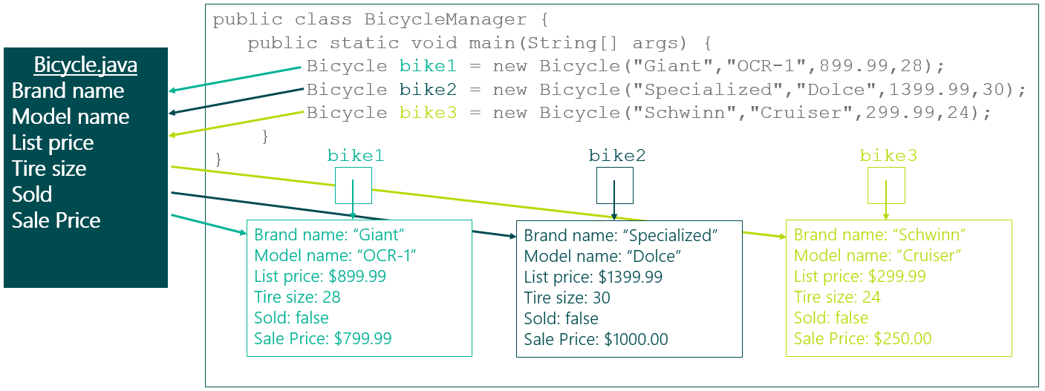
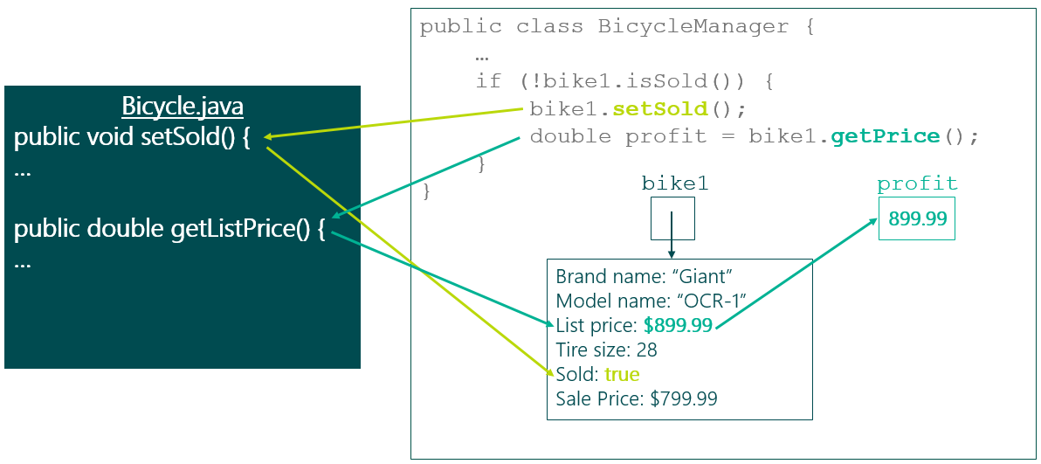
Manipulating objects in Client Class

Slide 11
State of an object, and encapsulation
Collection of values that are stored within an object's fields. Fields can be public or private.
Getters and Setters are used to see and manipulate the state, respectively.
public class Bicycle {
private double listPrice = 899.99;
private double salePrice = 599.99;
// Updates the price of the bicycle
public void setSale() {
listPrice = salePrice;
}
public double getSalePrice(){
return this.listPrice;
}
}
It is good practice to set all fields to private, and access and modify them through getters and setters in client class, inside main method.
Setter
Getter
Bicycle myBike = new Bicycle();
//Updating listPrice value of myBike
myBike.setSale(1000.00);

Slide 12
Behavior of an Object
Collection of methods within the object.
Represent the different thing we want our object to be able to do
// marks the bicycle as sold and returns
// the asking price for the customer
// during a sale
public double makeReducedPriceSale() {
isSold = true;
return salePrice;
}
//Our object's methods can access the field in other objects of the same type.
public boolean equals(Bicycle other){
return this.brand.equals(other.brand) && this.model.equals(other.model);
}

Slide 13
Constructors
client class creates objects by using the new operator.
The new operator calls an object contructor.
Contructors are special methods that creates instances and sets initial values.
Bicycle bike1 = new Bicycle("Giant","OCR-1",899.99,28);
public Bicycle (String myBrand, String myModel, double myPrice) { this.brand = myBrand;
this.model = myModel;
this.price = myPrice;
}
Has the same name as the name of the class
Does not specify return type, otherwise it would be a normal function

Slide 14
Default Contructors
If we don’t specify a constructor, java creates one for us by default. It would look like:
If we don’t specify constructor, then we cannot pass arguments to the new keyword in the client class:
public Bicycle() { }
Bicycle bike1 = new Bicycle();

Slide 15
Overloading Constructors
Allow users decide what amount of data to specify when creating objects, and what to rely on default values.
First create an initial constructor that initializes all fields.
Create other constructors with desired amount of parameters.
public Bicycle(String brand, String model, double listPrice) {
this(brand, model, listPrice, 28, false, listPrice);
}
// this uses all default values for a new Bicycle
public Bicycle() {
this("", "", 0.0, 28, false, 0.0);
}

Slide 16
Static Fields (class variable)
Their values are not specific to a single object.
They are shared by all objects of the same class
All objects can mutate this value, and would be the same for any of them.
Handy for:
Counting and statistics for all objects of the same class.
Shared values that all objects of the same class use (speed limit, gravity value, etc.)
public class MyClass{
private String field1;
private static int field2;
}
To reference outside the class, like in the client class; we use class name, not object name.
Bicycle bike1 = new Bicycle(); Bicycle bike2 = new Bicycle();
int bikeCount = Bicycle.bikeCount;

Slide 17
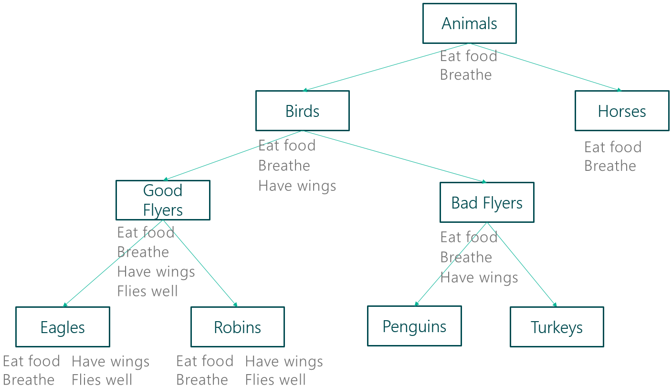
Inheritance
Formal Relations between classes’
SuperClasses and SubClasses
SubClasses inherit behavior from the SuperClass
SuperClasses are more generic, SubClasses are more specific.

